Slide 1
ب
ت
ث
Arabic Handwriting Evaluator
92.78%
test accuracy 29 letter classes
Automated letter recognition and handwriting feedback for children aged 7–12
Convolutional neural network trained on the Hijja dataset

Slide 2
The project in six steps
From a child's pencil stroke to a grade and a piece of advice
١
Collect
٢
Preprocess
٣
Split
Hijja: 47,434 letters handwritten by 591 children aged 7–12, covering every positional form.
One entry point for photos and dataset rows — a clean glyph passes straight through, a photo gets cleaned up.
Stratified 90/10 train and validation; the test set is sealed until the very end.
29 CLASSES
32×32 NORMALISED
34,139 / 3,794 / 9,501
٤
Train
٥
Evaluate
٦
Score
Six convolutional layers plus a classifier, light augmentation, 30 epochs, CPU only.
Held-out accuracy, a per-letter table and a 29×29 confusion matrix to see WHICH letters fail.
Grade a photograph against the letter the child was asked to write, then coach the child and the teacher.
2,048-D FEATURES
92.78% ACCURACY
3 GRADE TIERS

Slide 3
What the system does
From a photo of a letter on paper to coaching a child can act on
١
٢
٣
Recognise
Score
Coach
Identifies which of the 29 Arabic letters the child wrote, from a phone photo or scan of ruled paper.
Returns a similarity score for the letter the child was ASKED to write — not merely the one the model liked best.
Prints actionable feedback for the child and a checklist for the parent or teacher: grip, baseline, height, stroke order, dots.
Grades: ≥ 85% Excellent · 65–84% Good · < 65% Needs Improvement

Slide 4
The Hijja dataset
Handwriting collected from Arabic-speaking school children in Riyadh, 2019
47,434
591
29
7–12
characters
child writers
letter classes
years old
Why it is hard
Split used
Strokes are only 1–2 pixels wide at 32×32, and anti-aliased.
Each class mixes isolated, initial, medial and final letter forms.
Children's letters vary wildly in size, slant and steadiness.
Train
34,139 (90%)
Validation
3,794 (10%, stratified)
Test
9,501 (held out, untouched)

Slide 5
29 classes
28 letters in alphabetical order, plus hamza — many differ only by their dots
ا
ب
ت
ث
ج
ح
خ
د
ذ
ر
alef
beh
teh
theh
jeem
hah
khah
dal
thal
reh
ز
س
ش
ص
ض
ط
ظ
ع
غ
ف
zain
seen
sheen
sad
dad
tah
zah
ain
ghain
feh
ق
ك
ل
م
ن
ه
و
ي
ء
qaf
kaf
lam
meem
noon
heh
waw
yeh
hamza
ن
15 of the 29 letters are distinguished ONLY by dot count and position — ب one below, ت two above, ث three above. Losing a 2-pixel dot in preprocessing turns one letter into another.

Slide 6
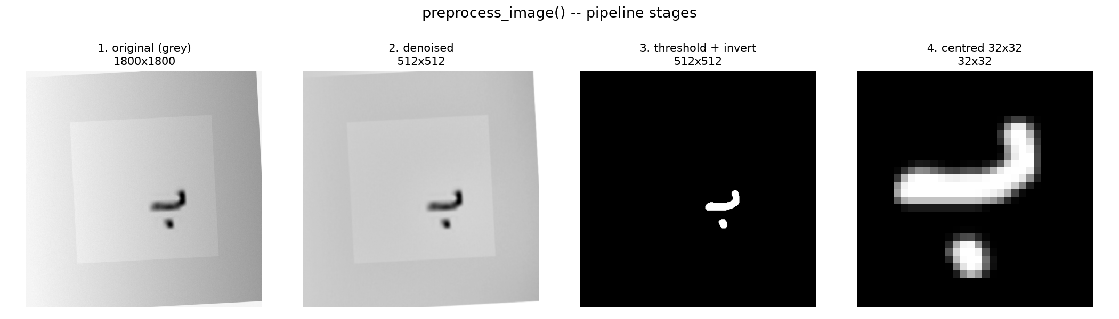
Preprocessing a photo of paper
One shared entry point; the cleanup runs only where it is needed
01
02
03
04
05
06
Grayscale
Denoise
Flatten light
Binarise
Crop & scale
Centre
handle BGR / BGRA
median + Gaussian 3×3
divide by blurred background
Otsu + auto-invert
aspect kept, longest side 21 px
centre of mass
Illumination flattening lifted IoU from 0.36 to 0.47 on shadowed photos; a polarity check prevents Otsu from splitting the paper when the letter is under 2% of the frame.

Slide 7
The finding that mattered
Applying the photo pipeline to clean dataset images halved accuracy
Raw dataset pixels
Forced through the photo path
88.2%
43.1%
Six epochs, no augmentation. Strokes left untouched.
Identical model, seed and split. Only the pixels differed.
Why: Otsu promotes every faint anti-aliased edge pixel to solid ink, taking an image from 90 ink pixels to 222 — thin letters become blobs. Re-scaling and re-centring then discard size and baseline position.
Fix: dataset rows pass through untouched; photos are normalised to match THEM instead.

Slide 8
From 4.6% to 92.78%
Three separate faults, found by controlled experiment rather than guesswork
SYMPTOM
ROOT CAUSE
FIX
RESULT
Validation stuck at 4.6%
BatchNorm running statistics have not converged in epoch 1, so validation scores near-random while training is already at 33%.
Read the curve from epoch 3 onward — the model corrects itself.
78.4%
Accuracy capped near 43%
The photo pipeline was forced onto clean dataset glyphs. Otsu turned 1–2 px anti-aliased strokes into blobs: 90 ink pixels became 222.
Clean-glyph fast path — dataset rows pass through untouched.
88.2%
Photos did not match training
Scanned letters were normalised to a 24 px box, but real Hijja glyphs average 20.9 px.
INK_BOX = 21 px, so a photo lands in the distribution the model learned.
92.8%
Each row was isolated by re-running the same model, seed and split and changing one thing — the pixels, not the hyper-parameters.

Slide 9
Model architecture
A feature extractor and a classifier, deliberately kept separate
Block 1
Conv 32 ×2 → BN → ReLU → MaxPool → Dropout 0.15
32×32 → 16×16
2,048
Block 2
Conv 64 ×2 → BN → ReLU → MaxPool → Dropout 0.20
16×16 → 8×8
dimensions in the extracted feature vector
Block 3
Conv 128 ×2 → BN → ReLU → MaxPool → Dropout 0.25
8×8 → 4×4
Features
Flatten — the transfer-learning handle
2,048-d vector
819k
Classifier
Dense 256 → BN → ReLU → Dropout 0.40
256
trainable parameters — runs on CPU
Output
Dense 29 → softmax
29 classes

Slide 10
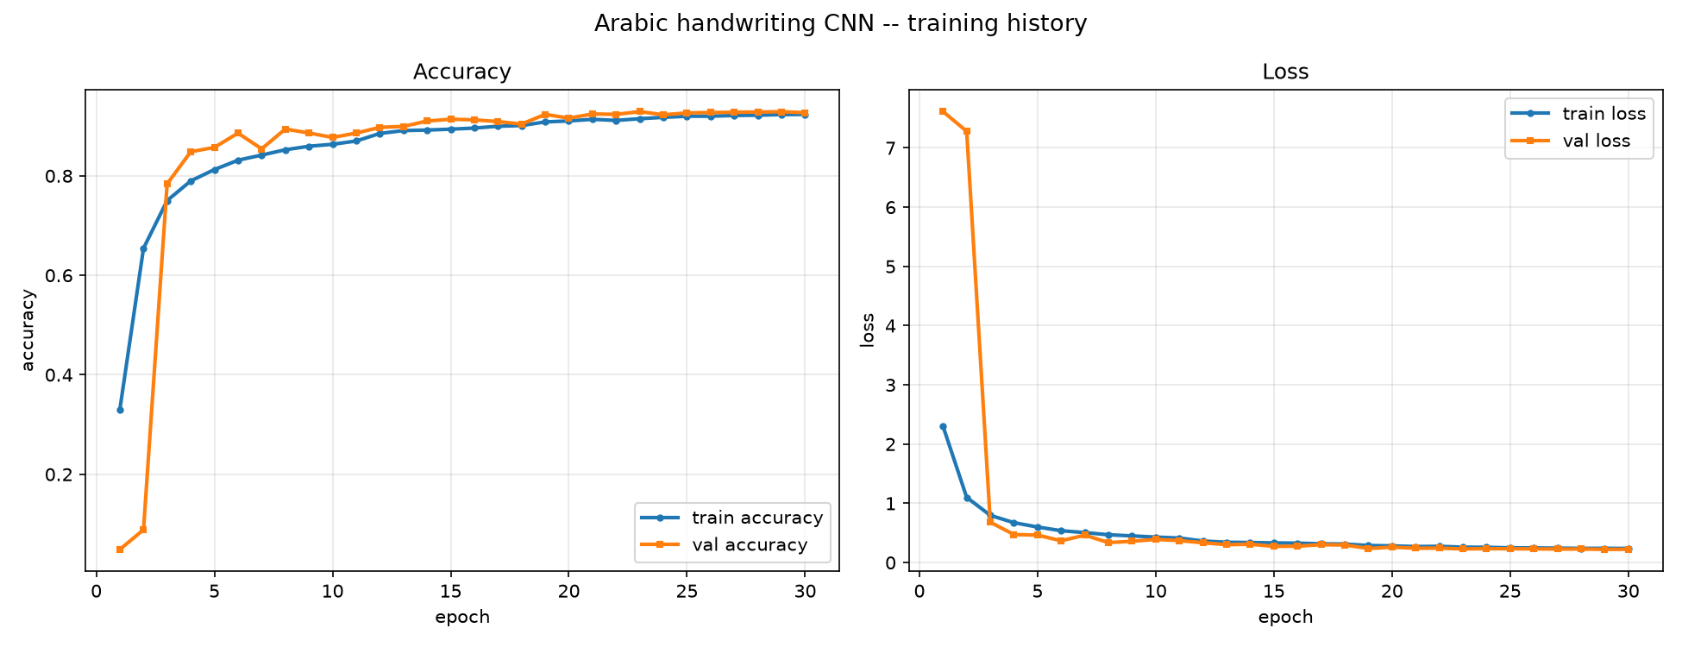
Training
30 epochs, batch 128, Adam 1e-3, light augmentation only
Augmentation
Rotation ±8°, shift 6%, zoom 5%. No flips, no shear — a mirrored Arabic letter is a wrong letter.
Callbacks
ModelCheckpoint on val accuracy EarlyStopping, patience 7 ReduceLROnPlateau ×0.5
Ignore the first two epochs: BatchNorm running statistics have not converged, so validation accuracy reads near-random (4.9%) while training accuracy is already 33%.

Slide 11
Results on the held-out test set
9,501 characters the model never saw during training
92.78%
92.32%
0.234
test accuracy
macro-average per letter
test loss

Slide 12
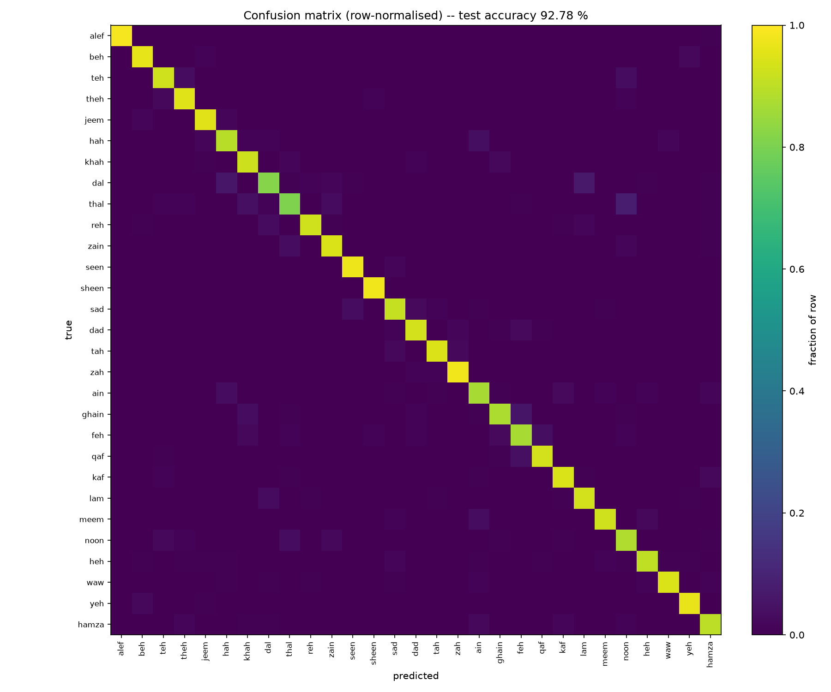
Where it still fails
Almost every remaining error is a dot, not a shape
ذ
thal
80.7%
confused with ن — 13 times
د
dal
82.0%
confused with ل — 12 times
ف
feh
87.0%
confused with ق — one dot apart
ع
ain
87.1%
confused with ح — the dot decides
غ
ghain
87.5%
confused with ف — 20 times
د ↔ ذ and ع ↔ غ differ by a single dot.

Slide 13
The scoring engine
What a child and a teacher actually receive
🌟
Excellent
≥ 85%
Sample report — target ب (beh)
clear and well formed — move on to the joined forms
Recognised: ن (noon) Similarity: 15.0%
Grade: Needs Improvement ✏️
For the child
Hold the pencil with THREE fingers. Start from the RIGHT, write the body in one stroke, add the dots LAST. ب takes ONE dot BELOW.
For the parent / teacher
Check grip, baseline, letter height, stroke order, and dot count. Look-alike family: ب ت ث ن ي.
👍
Good
65–84%
readable — tidy the baseline and smooth the curve
✏️
Needs work
< 65%
revisit grip, stroke order and the dots

Slide 14
Where it stands
Verified on this machine, CPU only
Delivered
Honest limitations
92.93% test accuracy across 29 classes
One self-contained script, CPU only, ~50 s per epoch
Photo scoring with child and teacher feedback
Pipeline tested against shadowed, tilted and blurred photos
The score is raw softmax confidence, not a calibrated similarity — a confident but malformed letter can still score highly.
The photo branch is validated on synthetic photos; it needs calibrating against real ink on real paper.
Hijja mixes letter forms per class, which caps what 29-way accuracy can mean.
ء
Next: calibrate confidence on the validation set, and tune the photo branch against photographs of real children's handwriting.

